Slide 1
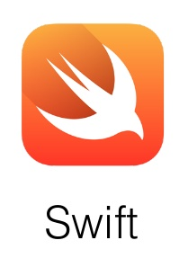
CS 360 Programming Languages

Slide 2
Welcome!
We have 14 weeks to learn the fundamental concepts of programming languages.
With hard work, patience, and an open mind, this course makes you a much better programmer
Even in languages we won’t use
Learn the core ideas around which every language is built, despite countless surface-level differences and variations
Poor course summary: “We learned Racket.”
Today’s class:
Course mechanics
[A rain-check on motivation]
Dive into Racket, our first new language

Slide 3
Concise to-do list
In the next 24-48 hours:
Find course web page: go to pkirlin.github.io/pl-s23
Read course syllabus.
Get set up using DrRacket.
Installation/configuration/use instructions on web page
Essential; no reason to delay

Slide 4
Staying in touch
Piazza – a message board for college classes
For appropriate discussions and announcements
Use to get help – everyone can post and respond to questions. Can even post and respond anonymously!
Just don’t post any code that gives away homework answers or parts of answers.

Slide 5
Syllabus: Office hours
Regular hours and locations on syllabus and webpage.
Changes as necessary announced on email list.
Use them
Please visit me.
Ideally not just for homework questions (but that’s good too).

Slide 6
Syllabus: Textbooks, or lack thereof
No required textbook
I will provide online references for details you want/need to know.
Lots of additional online resources we will use to cover Racket and advanced Java topics.

Slide 7
Syllabus: Workload
Homework/projects, midterm, final exam.
Make note of midterm and final exam dates.
Bring academic accommodation forms to me ASAP.

Slide 8
Syllabus: Projects
Roughly 6-7 total, including a final project
To be done individually, unless otherwise specified (final project likely in pairs)
Doing the projects involves:
Understanding the concepts being addressed
Writing code demonstrating understanding of the concepts
Testing your code to ensure you understand and have correct programs
“Playing around” with variations, incorrect answers, etc.
I grade only (2), but focusing only on (2) makes your life more difficult

Slide 9
Laptops
There will be times when we will be programming in class in partners.
I will announce these times in advance and suggest you bring a laptop if you can.
I will make sure each pair of people has a computer between them.

Slide 10
Academic Integrity
Rule of thumb – don’t look at anyone else’s code, correct or incorrect.
You are to complete assignments individually.
You may discuss assignments in general terms with other students including a discussion of how to approach a problem, but the code you write must be your own.
You may get help when you are stuck, but this help should be limited and should never involve details of how to code a solution.
You may not have another person (current student, former student, tutor, friend, anyone) "walk you through" how to solve an assignment.

Slide 11
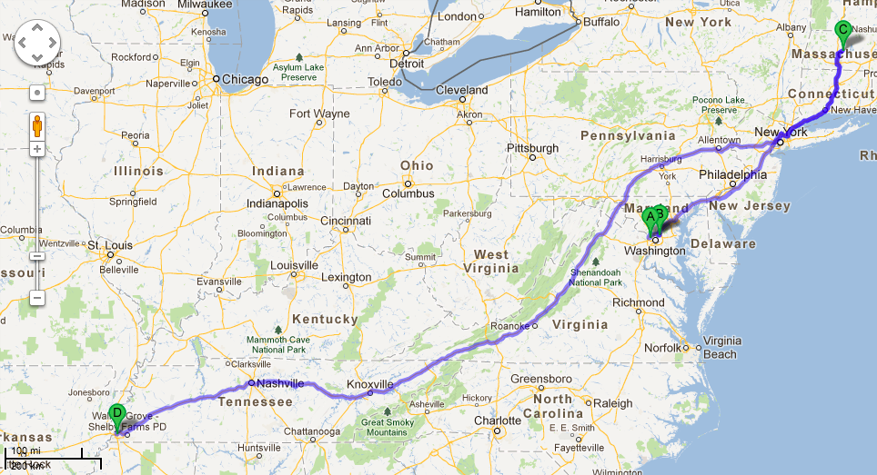
A little about me

Slide 12
A little about you
Name (what you want us to call you)
Pronouns (optional)
Year at Rhodes (first-year, sophomore, etc.)
Where you're from (however you want to interpret it)
Something boring that you have a strong opinion about.

Slide 13
Questions?
Anything I forgot about course mechanics before we discuss, you know, programming languages?

Slide 14
What this course is about
Many essential concepts relevant in any programming language
And how these pieces fit together
Use Racket and Java (possibly others) because:
They let many of the concepts “shine”
Using multiple languages shows how the same concept can “look different” or actually be slightly different in another language
A big focus on functional programming
No mutation (assignment statements) (!)
No loops! Only recursion!
Using first-class functions (can’t explain that yet)

Slide 15
What this course is about
For at least the next two weeks, “let go of Java and Python”
Learn Racket as a “totally new way of programming”
Later we’ll contrast with what you know
Saying “oh that is kind of like that thing in Java/Python” will confuse you, slow you down, and make you learn less
In a few weeks, we’ll have the background to
Intelligently motivate the course
Understand how functional programming is often simple, powerful, and good style – even when using Python or Java
Understand why functional programming is increasingly important in the “real world” even if Racket/Scheme/Lisp aren't widely popular languages in industry.

Slide 16
My claim
Learning to think about software in this “PL” way will make you a better programmer even if/when you go back to old ways.
It will also give you the mental tools and experience you need for a lifetime of confidently picking up new languages and ideas.

Slide 17
A strange environment
The next few weeks will use
The Racket language (a variant of Scheme)
The DrRacket editing environment
A read-eval-print-loop (REPL) for evaluating programs
You need to get things installed, configured, and usable
On your own machine
Instructions are online (read carefully; ask questions)
Working in strange environments is a CS life skill

Slide 18
Let's hop over to DrRacket

Slide 19
A very simple Racket program
; My first Racket program
(define x 3)
(define y 7)
(define z (- x y))
(define q (* (+ x 2) (- z 3)))
(define abs-of-z (if (< z 0) (- z) z))

Slide 20
Racket from the beginning
A Racket program is a sequence of definitions and expressions
A definition binds a value to a variable.
An expression is something that can be evaluated.
Expressions always evaluate to a value (definitions never do).
Each binding or expression is evaluated in the order they appear, using the environment produced by any previous definitions and expressions.
An environment holds variables and their values (bindings).
A value is the result of evaluating an expression.
Let's run through how the environment would look for our sample program.
Notes:
GO THRU PROGRAM HERE WITH ENVIRONMENT

Slide 21
Syntax vs semantics
Syntax is how you write something.
Semantics is what that something means.
Type-checking (at run time in Racket)
Evaluation (as the program runs)

Slide 22
Definitions
(define q (* (+ x 2) (- z 3)))
More generally:
(define x e)
Syntax:
Keyword define
Variable x
Expression e
many forms of these, most containing subexpressions
Semantics:
Evaluate the expression e and add a binding to the current environment.

Slide 23
Expressions
We will see many kinds of expressions:
3 1/4 #f #t x (+ e1 e2) (* e1 e2)
(if test e1 e2)
Can get arbitrarily large since any subexpression can contain subsubexpressions, etc.
Syntax and semantics vary depending on type of expression.

Slide 24
Expressions: Variables
Syntax:
sequence of letters, digits, hyphen, underscore, not starting with digit
sometimes called identifiers
Type-checking:
Not applicable
Evaluation:
Look up value in current environment

Slide 25
Expressions: Addition
Syntax:
(+ e1 e2) where e1 and e2 are expressions
Type-checking:
If e1 and e2 have type integer,
then (+ e1 e2) has type integer
(also rational, real, complex)
Evaluation:
If e1 evaluates to v1 and e2 evaluates to v2,
then (+ e1 e2) evaluates to sum of v1 and v2

Slide 26
Expressions: Values
All values are expressions
Not all expressions are values (but all expressions evaluate to values)
A value “evaluates to itself” in “zero steps”
Examples:
34, 17, 42 have type integer
#t, #f have type boolean

Slide 27
A slightly tougher one
What are the syntax, typing rules, and evaluation rules for less-than expressions?
What are the syntax, typing rules, and evaluation rules for if expressions?
Notes:
In other words, what happens when I type the expression (

Slide 28
The foundation we need
We have many more expressions to learn before we can write “anything interesting”
Syntax, typing rules, evaluation rules will guide us the whole way!
Preview of what’s to come:
Mutation (a.k.a. assignment): use new bindings instead
Statements: everything is an expression (well, except definitions)
Loops: use recursion instead

Slide 29
Pragmatics
Lecture has emphasized building up from simple pieces
But in practice you make mistakes and get inscrutable messages
Example gotcha: (define x = 7) instead of (define x 7)
Work on developing resilience to mistakes
Slow down
Don’t panic
Read what you wrote very carefully

